Slide 1
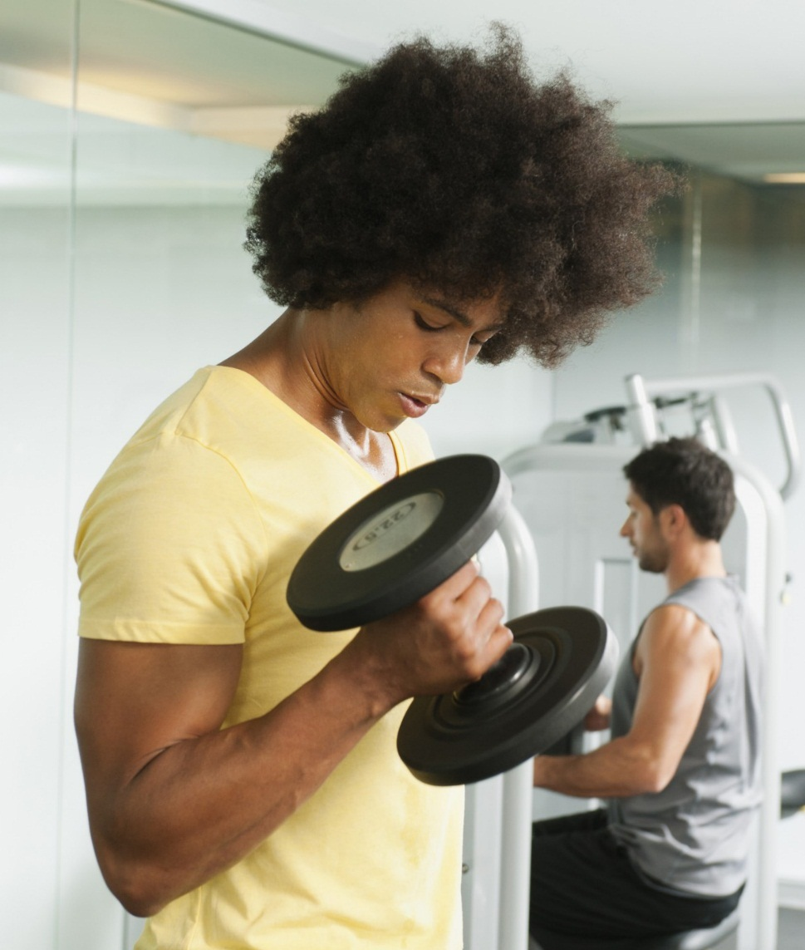
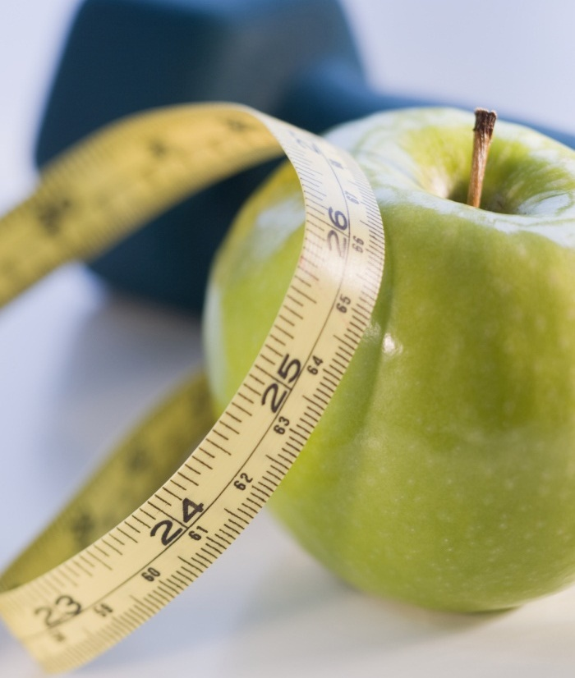

WORKOUT PLANNER
BY: Mikale hodges & ansh patel

Slide 2
Table of contents
WHAT THE PLANNER DOES?
REASON TO USE PLANNER.
HOW TO GET A WORKOUT PLAN? (WALKTHROUGH)
LINK FOR PLANNER
GROUP MEMBERS

Slide 3

What the Planner does?
The planner simplifies different workouts into a schedule of workouts depending on the specific muscle you would like to workout. This planner simplifies the different movements for each workout to guarantee a good workout every session.

Slide 4
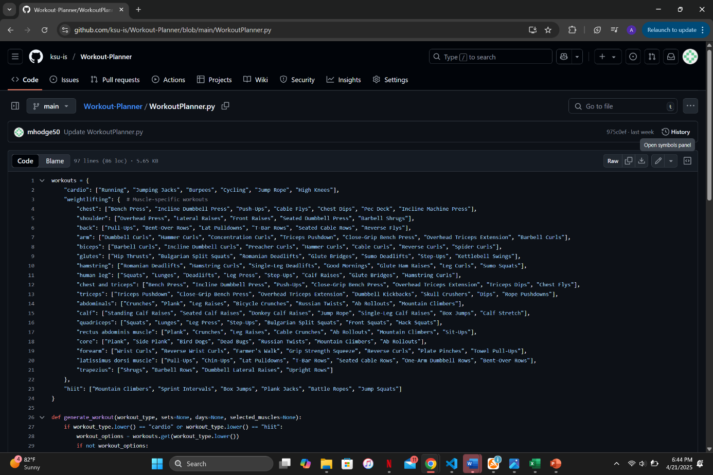
REASON To use planner.
Quickly access workouts anytime/anywhere
Gives a variety of workout choices.
EASY TO USE!

Slide 5
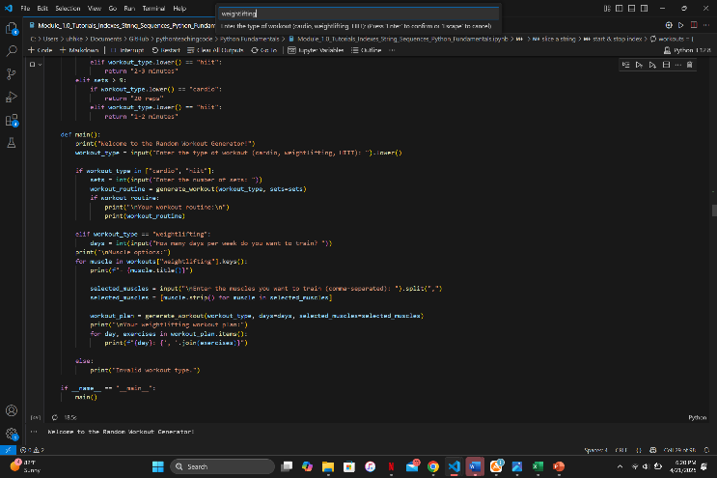
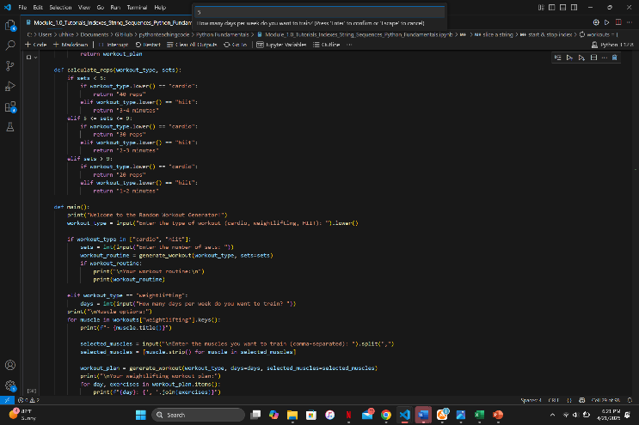
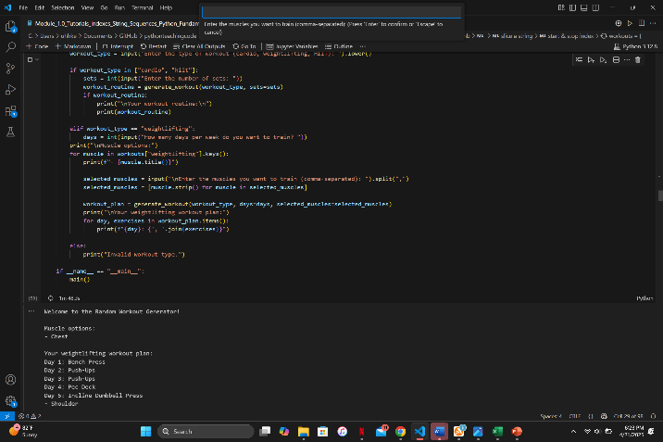
How to get a workout plan? (WALKthrough)
Step 1: ENTER the type of workout you are working on for the week.
Step 2: Enter # of days you are working out for
Step 3: Review the muscle movements for the specific workout you chose.
Step 4: HAVE A GOOD WORKOUT!

Slide 6
Link for planner
https://github.com/ksu-is/Workout-Planner
GIVE IT A TRY!!

Slide 7
GROUP MEMBERS
Mikale Hodges
mhodge50@students.Kennesaw.edu
Ansh Patel
apate304@students.Kennesaw.edu

